Slide 1
Support Vector Machines for binary classification

Slide 2
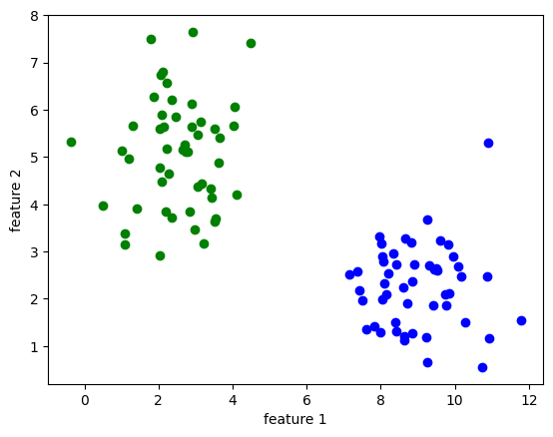
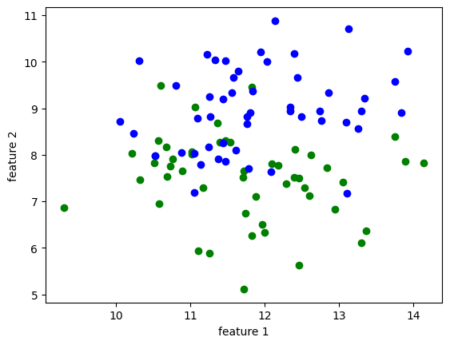
State the problem
?
Linear separable
Non-linear separable

Slide 3
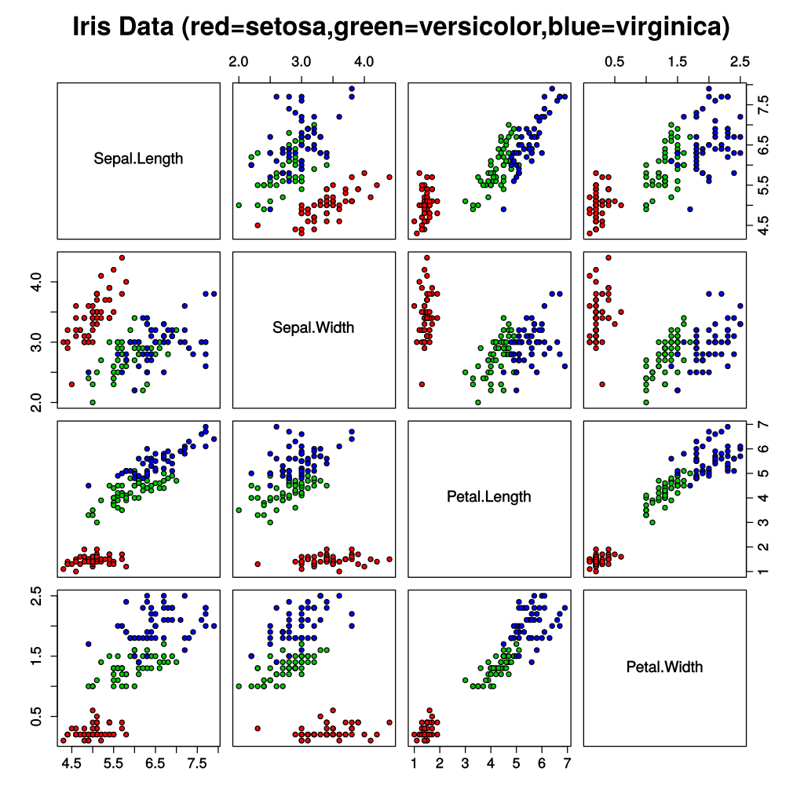
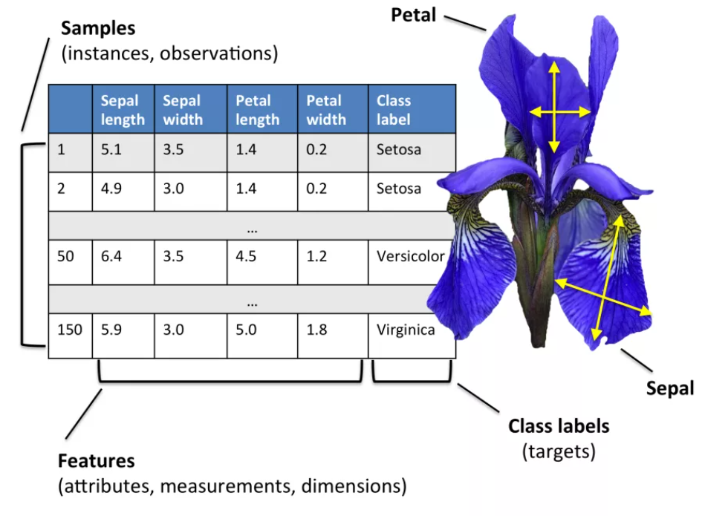
Example of multiclass classification
Fisher's Iris dataset

Slide 4
The Support Vector Classifier

Slide 5
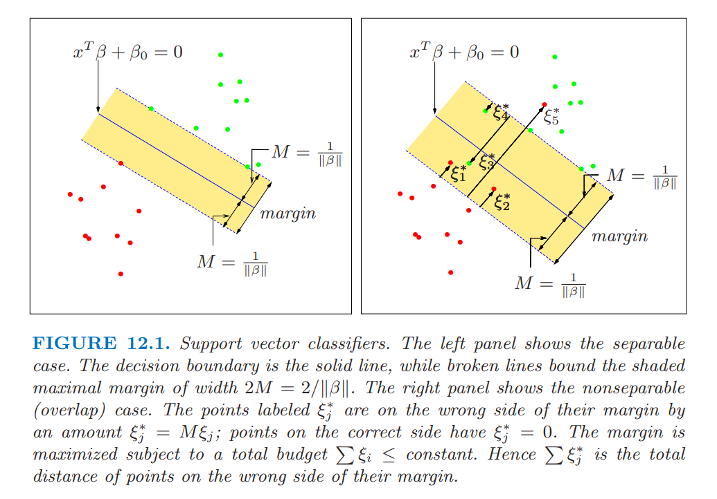

Slide 6
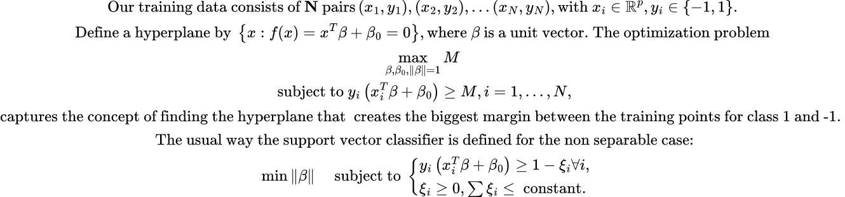
State the optimization problem

Slide 7
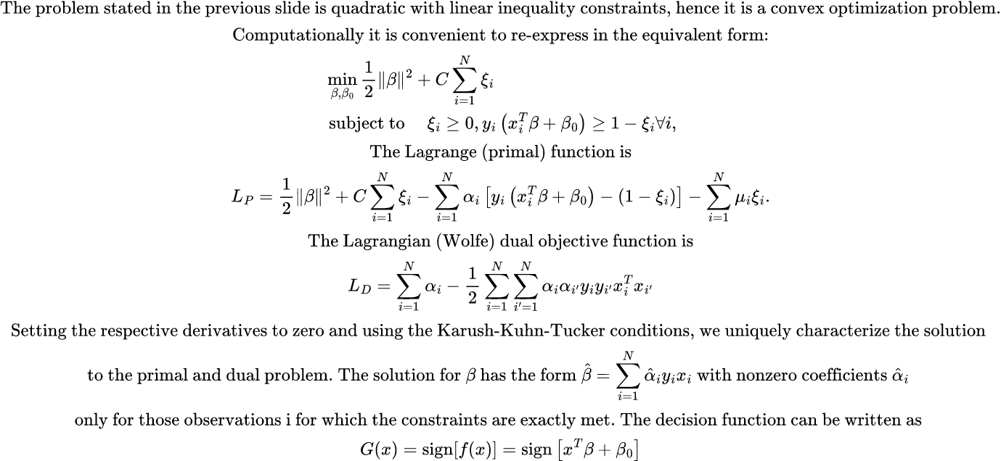
Decision Function

Slide 8
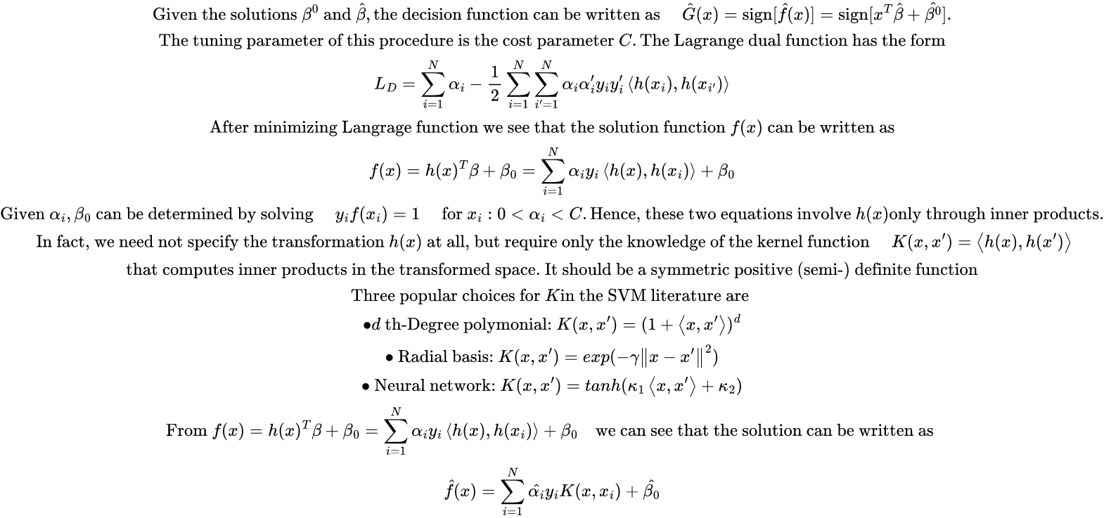
Generalization for nonlinear cases

Slide 9
Solution of the optimization problem

Slide 10
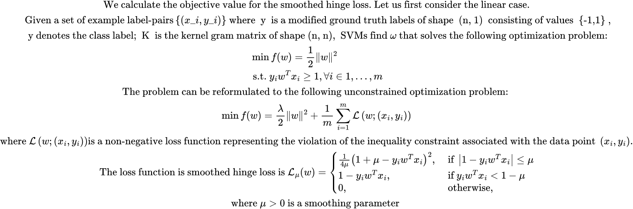
The objective function

Slide 11
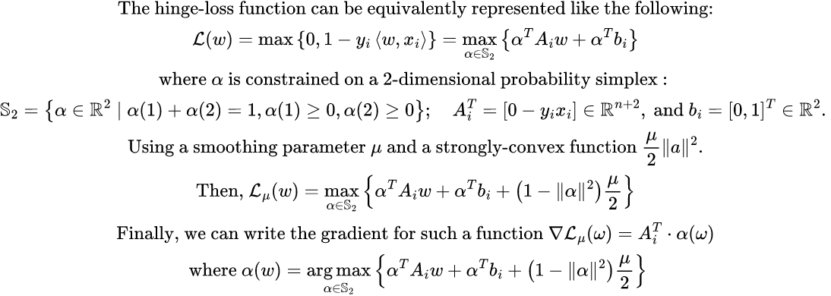
The Hinge loss as penalty

Slide 12
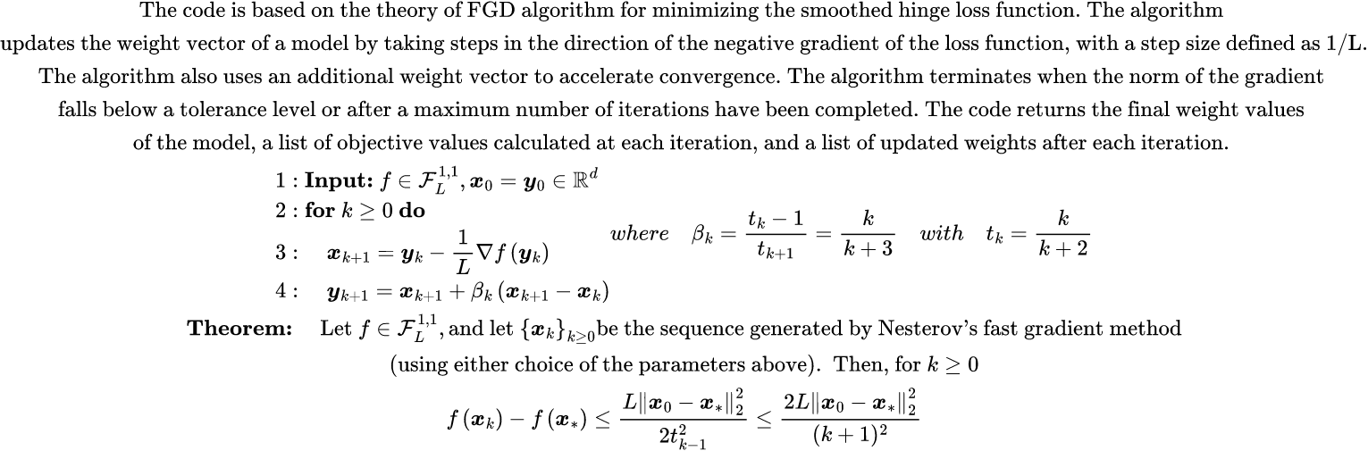
Nesterov’s Fast Gradient Method

Slide 13
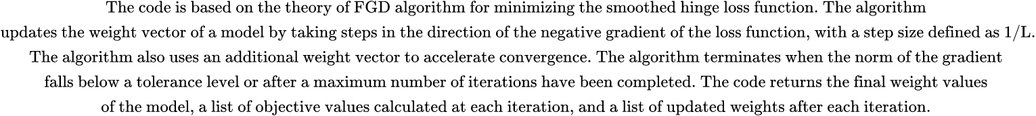
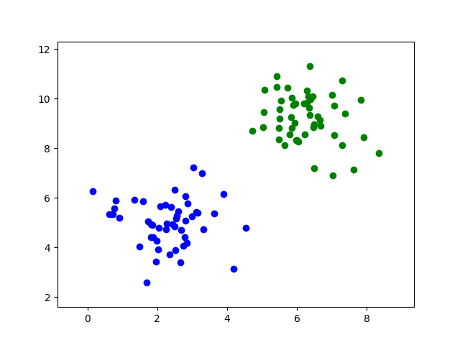
Nesterov’s Fast Gradient Method for SVM problem

Slide 14
Comparison of our results and the Python sklearn module

Slide 15
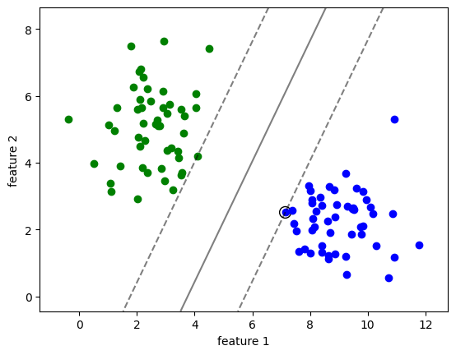
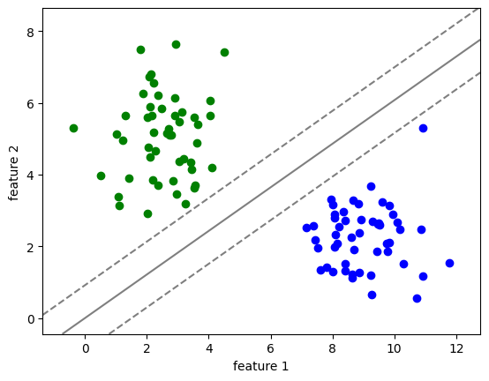
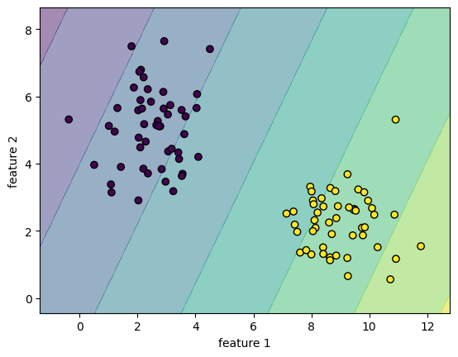
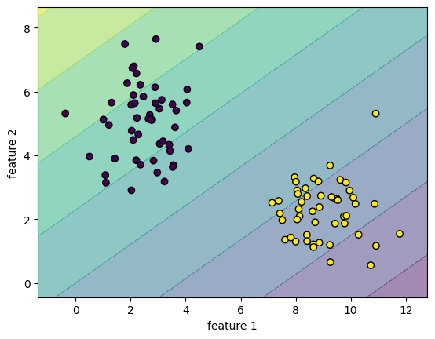
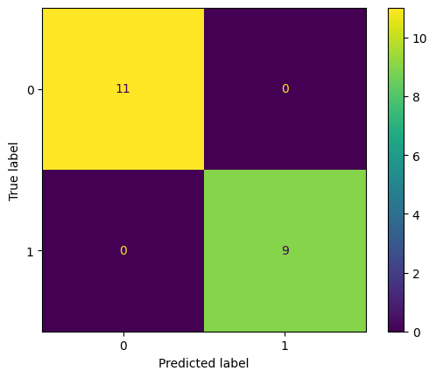
Exemplary separation
Source dataset
Our separation
Exemplary result
Our result
Accuracy = 1
Accuracy = 1
Exemplary confusion matrix
Our confusion matrix
Notes:
linear

Slide 16
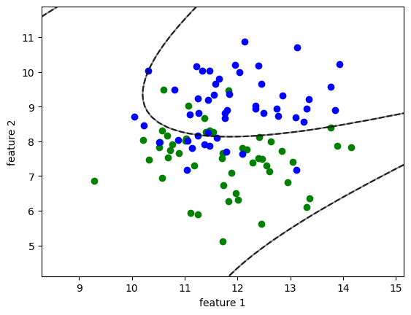
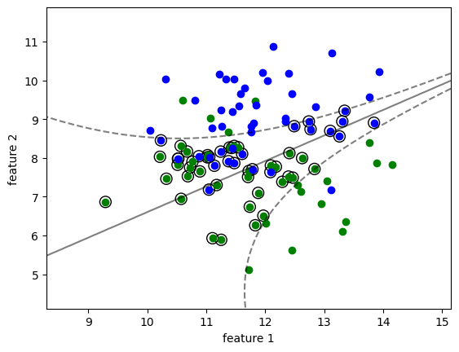
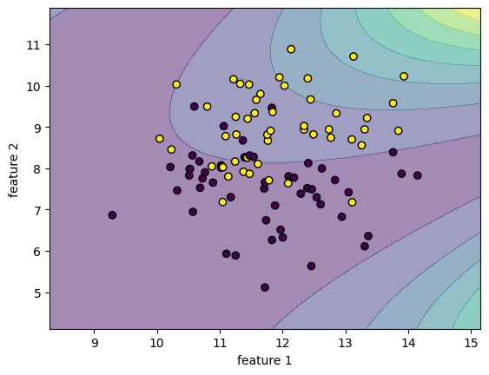
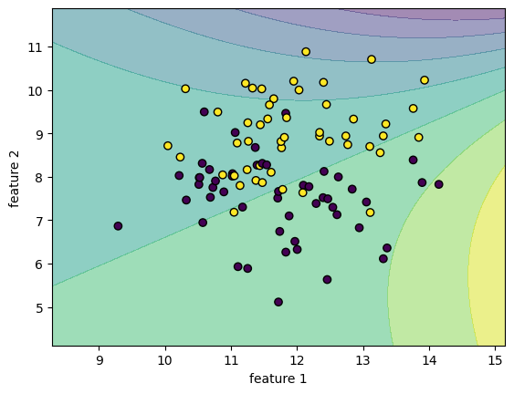
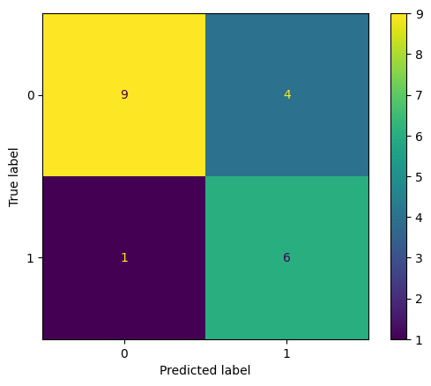
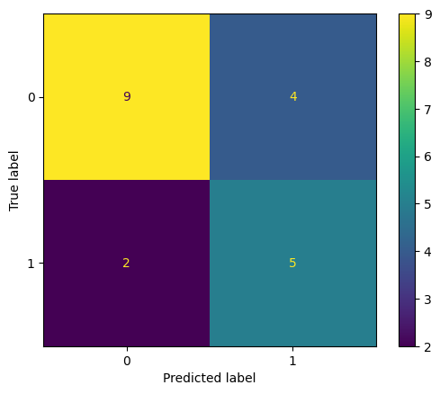
Exemplary separation
Source dataset
Our separation
Exemplary result
Our result
Accuracy = 0.75
Accuracy = 0.7
Exemplary confusion matrix
Our confusion matrix
Notes:
poly

Slide 17
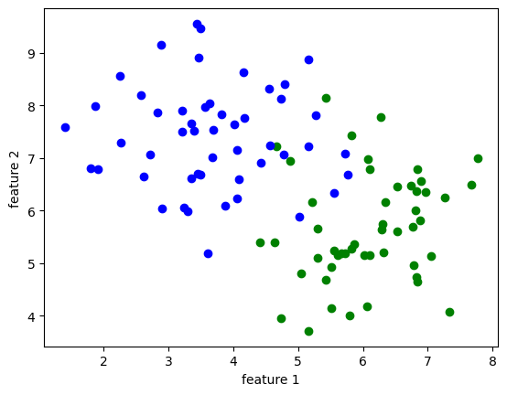
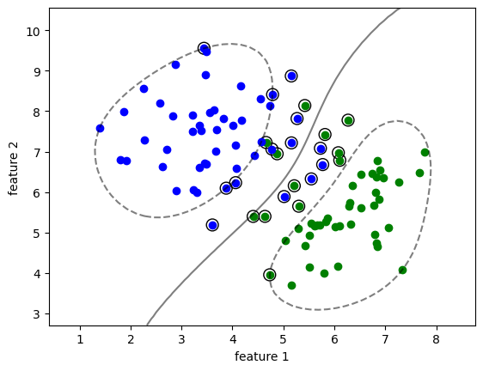
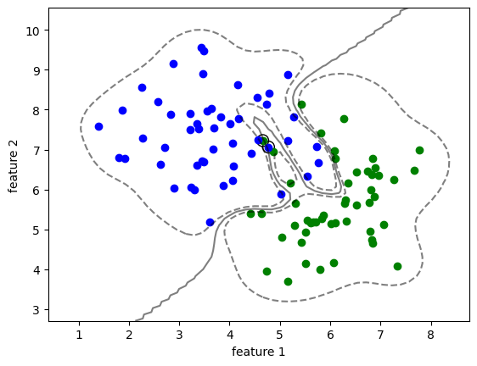
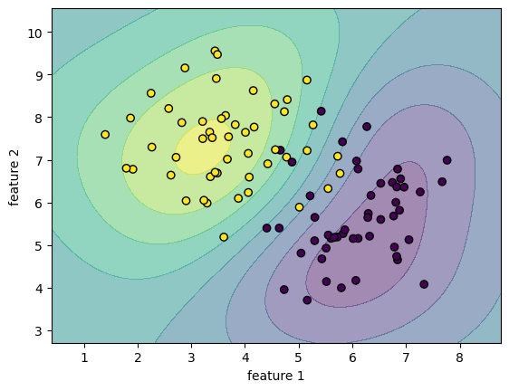
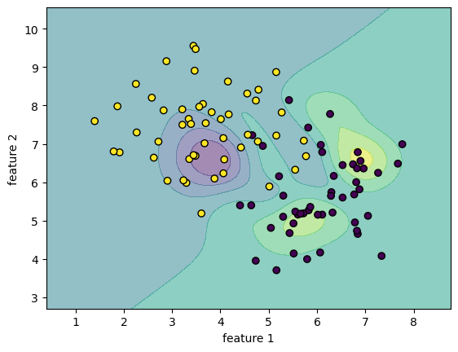
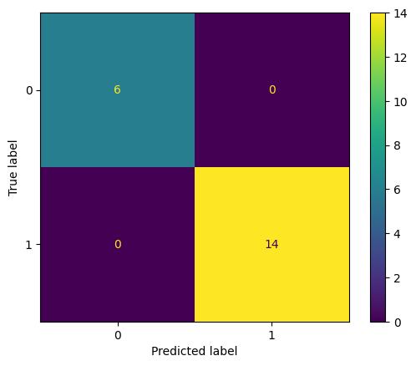
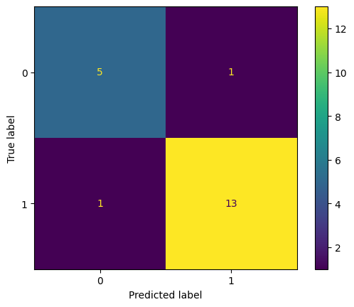
Exemplary separation
Source dataset
Our separation
Exemplary result
Our result
Accuracy = 1
Accuracy = 0.9
Exemplary confusion matrix
Our confusion matrix
Notes:
rbf

Slide 18
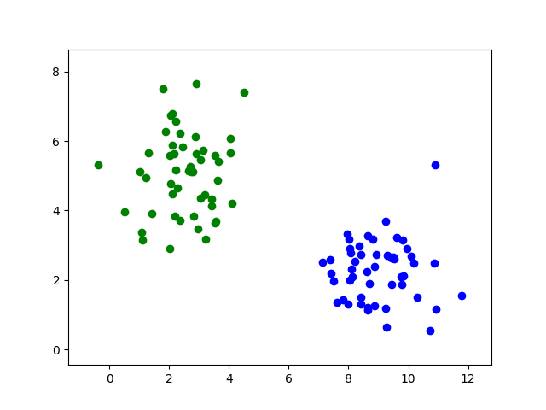
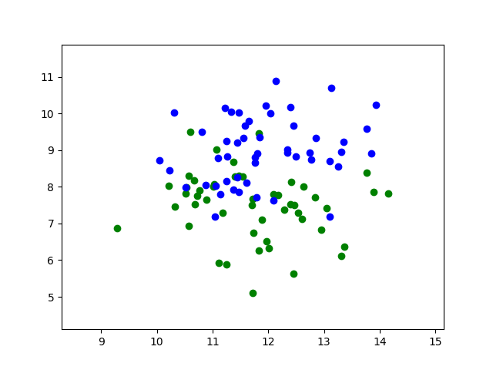
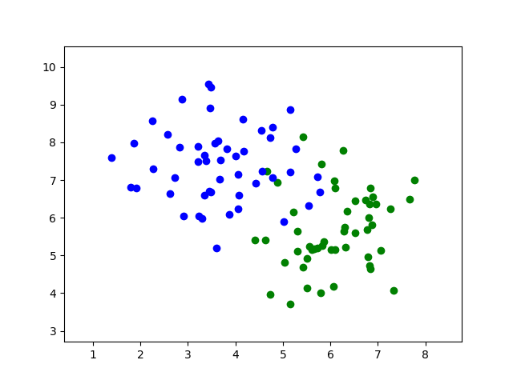
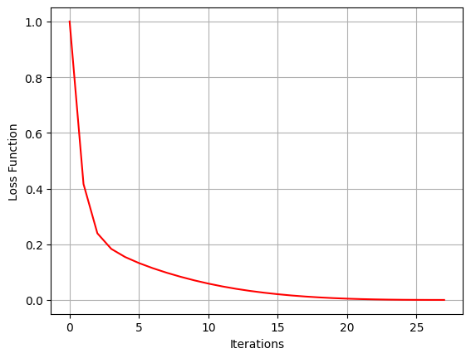
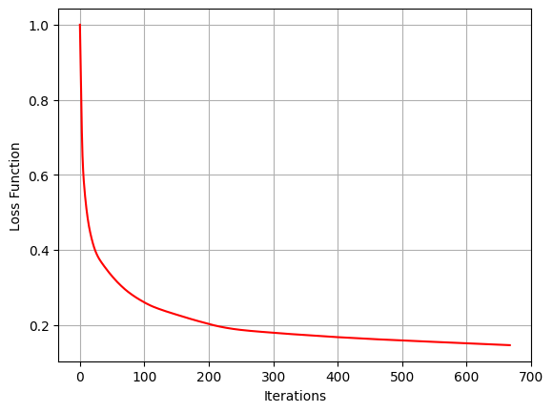
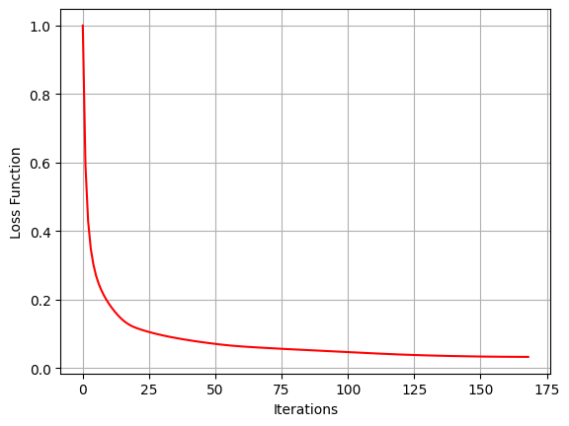
Linear Kernel
Polynomial Kernel
RBF kernel
Training
Training
Training

Slide 19


